Slide 1
DLX project presentation
Dario Castagneri
Gianpietro Noto
Francesca Silvano
October 28th 2022

Slide 2
Outline
Structural overview
Datapath
Hardwired Control Unit
IRAM and DRAM
Forwarding Load/Store
Forwarding Hazards
Windowed Register File
Arithmetic-Logic Unit
Automation scripts
Synthesis Results
Physical Design Results
.asm file: load and store + jump instructions
.asm file: forwarding hazards instructions
.asm file: branch instructions

Slide 3
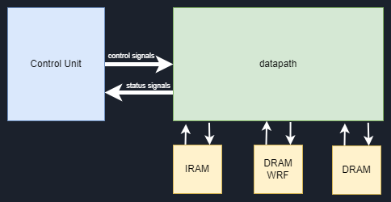
Structural Overview
Datapath containing 5 stages: Fetch,Decode,Execute,Memory,Write back.
Hardwired CU
It generates the control word used by the datapath for each operation
DRAM used by the datapath for the load and store operation
IRAM used in the fetch unit to get each instruction
DRAM used as a stack
for the register file

Slide 4
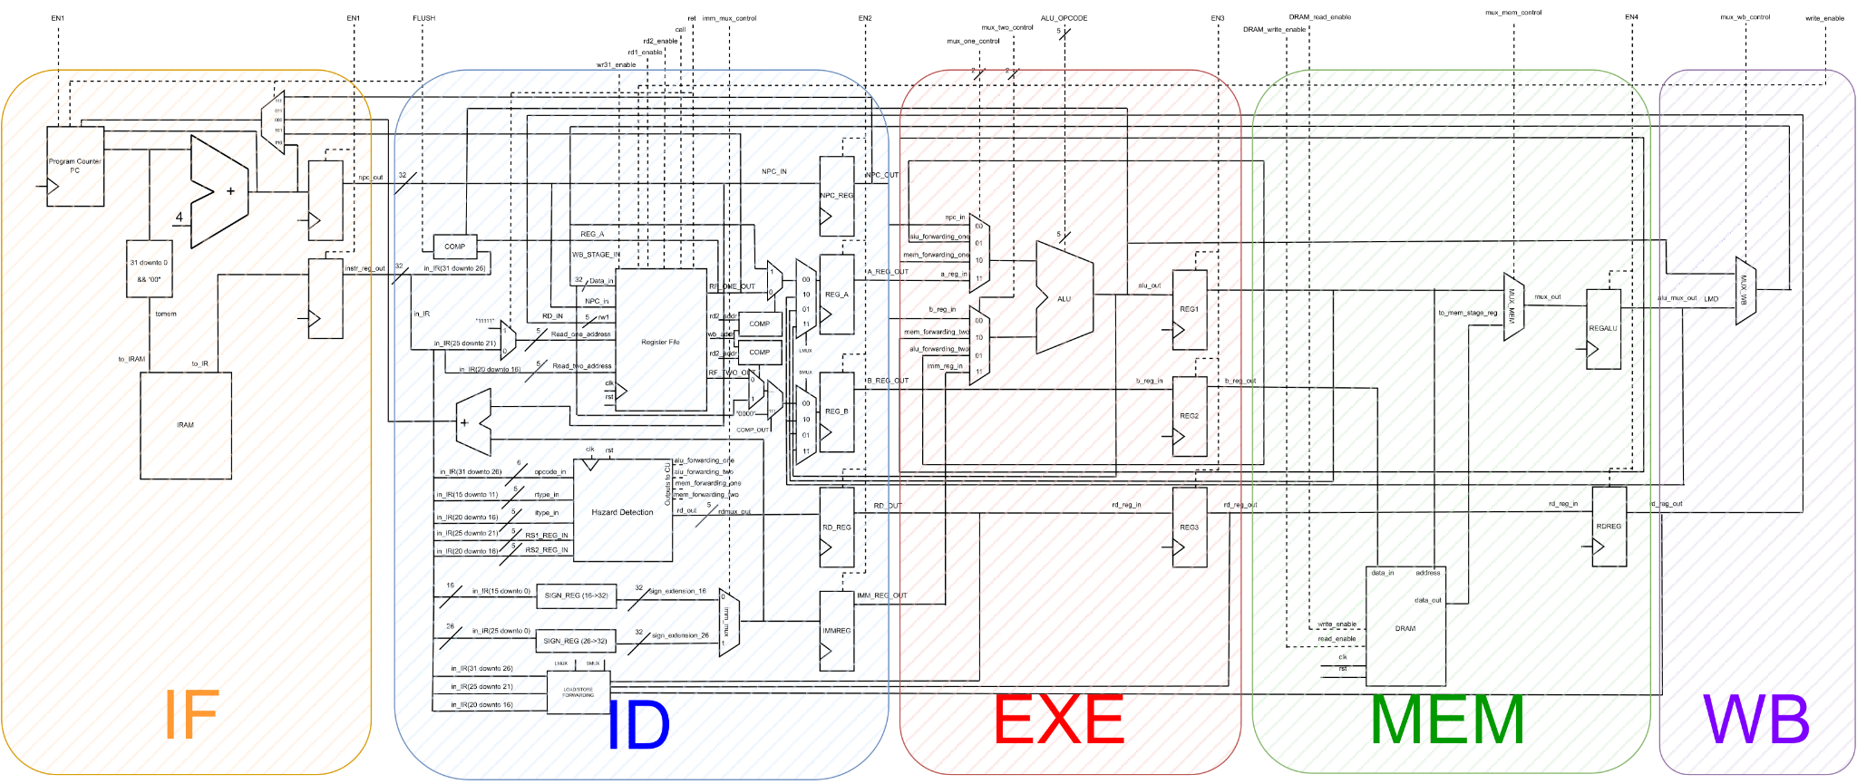
Datapath
The Datapath is divided in 5 stages. In this way the pipeline can be enabled and 5 instructions can be executed at a time.

Slide 5
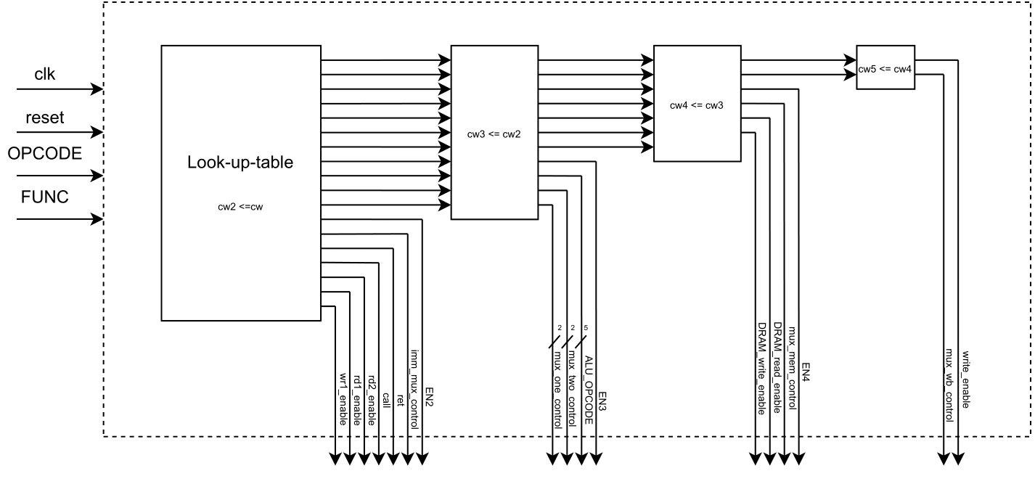
Hardwired Control Unit
Hardwired CU, it generates the control words used by the datapath to execute instructions.
When a new instruction is fetched by the datapath, the OPCODE and the FUNC are sent to the CU which generates the Control Word.
On the following clock cycle the generated Control Word is sent to the datapath which can perform the Decode of the fetched instruction.

Slide 6
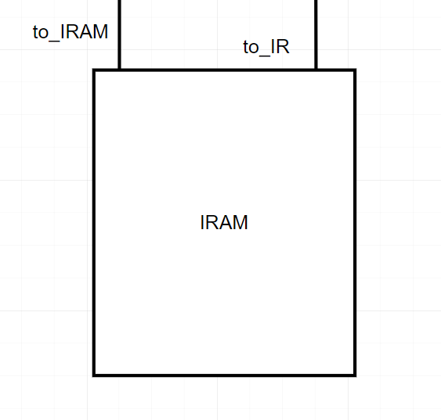
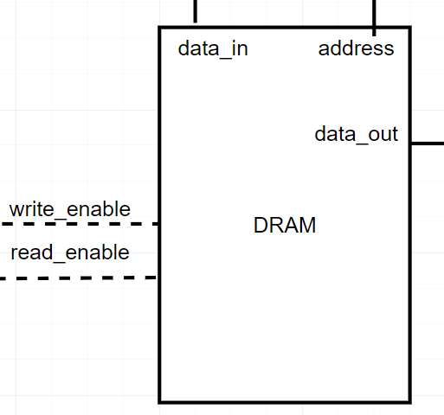
IRAM and DRAM
Cells are made of 8-bit, instructions are in 32-bit so they need 4 cells to be stored; memory organization is in Big Endian.
When the Reset = 1 the IRAM reads the file containing the instructions and store them.
Then when an external enable is activated every instruction is fetched in the rising clock edge and is passed to the following stage through an Instruction Register IR.
The DRAM is used in presence of Load/Store instructions. In order to read or store instruction the respective enable signals must be activated.
Since we are in a pipeline both memories must work in a combinatory way so that when the right address/data_in and write/read signals are given, the correct operation is performed.

Slide 7
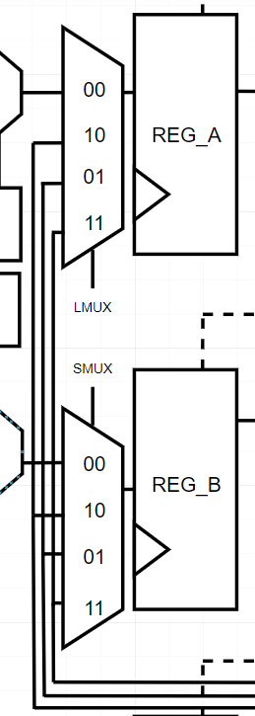
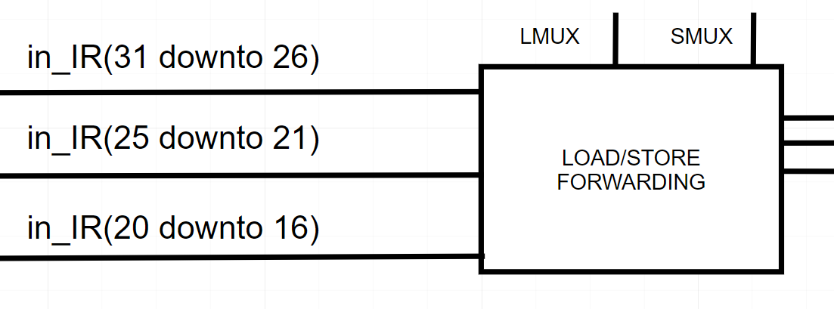
Forwarding Load/Store
The Load/Store Forwarding block is used to enable forwarding in presence of a Data Hazard for Load or Store instructions. The inputs of this block are the Opcode, the read 1 address (RS1) and the read 2 address (RS2) of the Register File, while on the other side we have in input the Destination registers RD from the following stage of the Pipeline. If the data that in the following clock cycles must be written in the Register File is present in the Pipeline, it is forwarded directly to the output of the Decode Unit; the right value is selected through the two 4TO1 Multiplexers used respectively for Load and Store instructions.

Slide 8
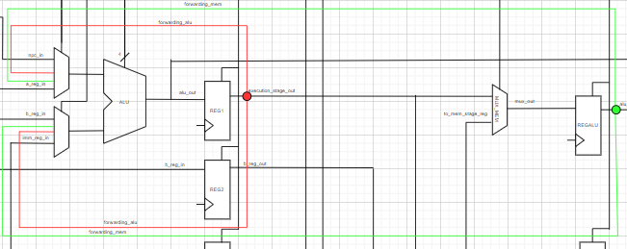
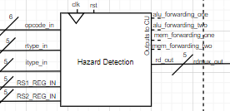
Forwarding Hazards
The DLX contains inside the decode phase a block to manage links between register of close instructions.
4 signal for forwarding
It check the opcode of the previous instruction with the new
if some hazard is possible checks the register destination with the register source
If the forwarding can be managed it pull up one of the signals otherwise the signal nop_add is pulled up

Slide 9
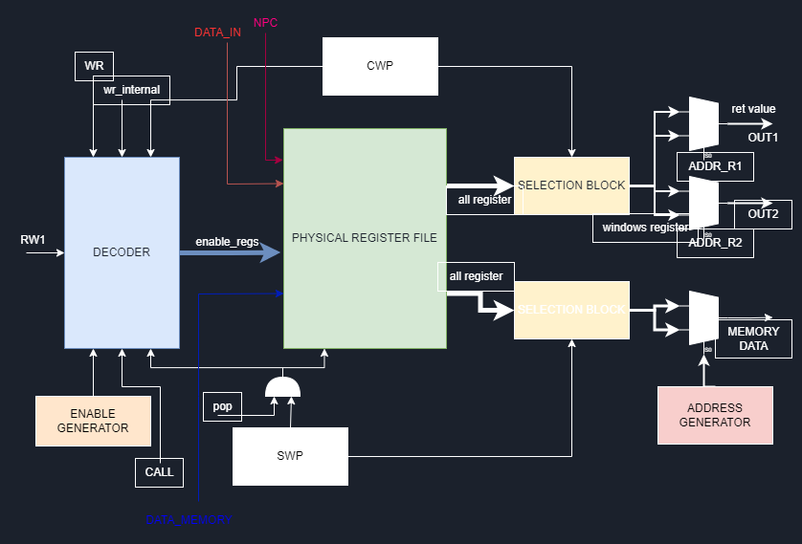
Windowed Register File
add_r1 and add_r2 selects the register going in the exit
call signals and ret signals perform the switch context
The address generator is useful when a push in the stack is performed
enable generators is used for the pop from the stack

Slide 10
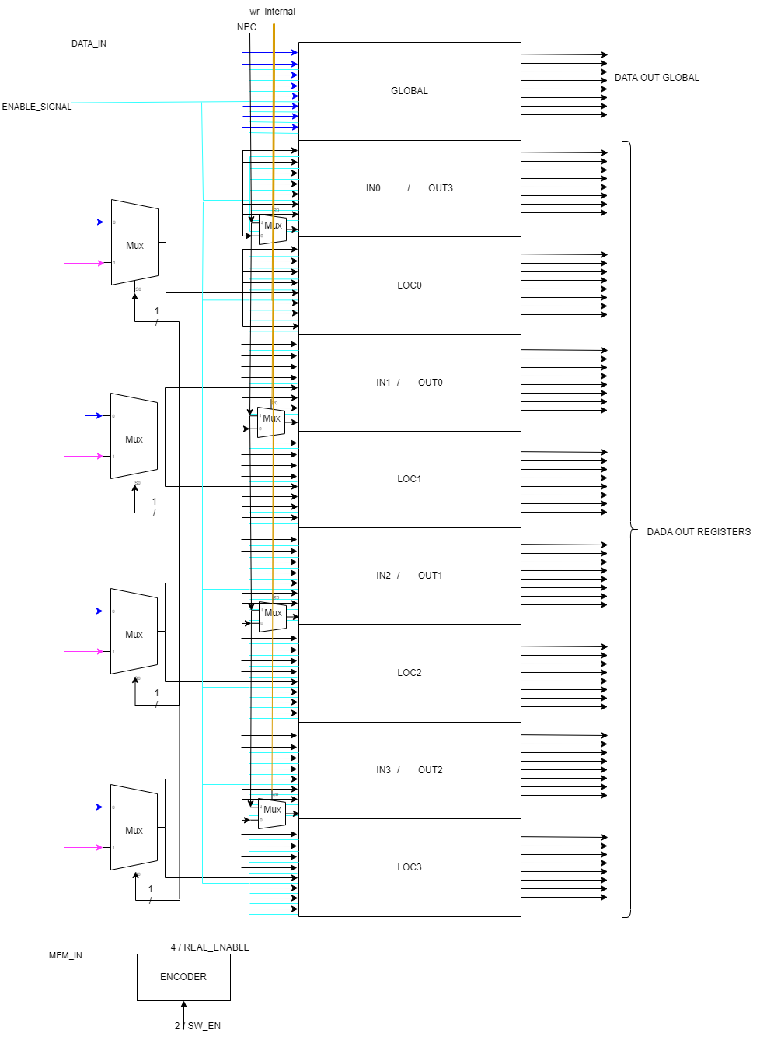
Windowed register file Physical register file

Slide 11
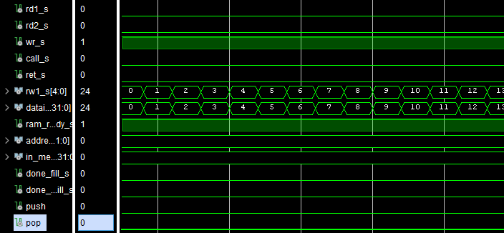
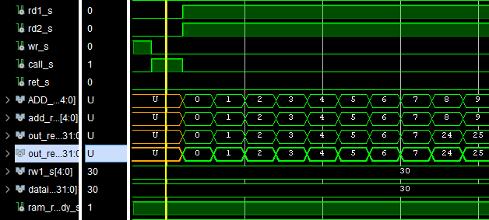
Windowed register file write and read operation test
The signal for the write wr_s is up, so the wrf take the data and the address from the outside and write in the correct register of the current windows.
Here a call is performed and a read of the input register from the previous windows.

Slide 12
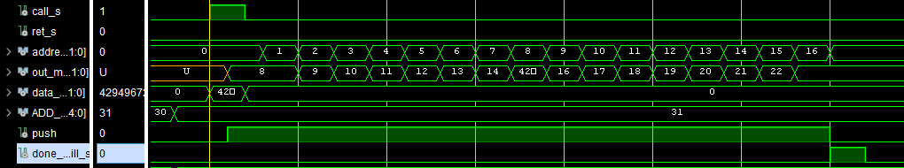
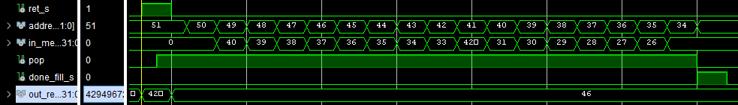
Windowed register file call and return operation test
The call operation with the use of the stack is quite easy:
-the address to return is saved in the R31
-the load of the registers is done when the push signal is at one
-when all is finished the done_fill signal is up
When a Return operation is performed:
-the address of the instruction is given in output in the first clk cycle

Slide 13
Arithmetic-Logic Unit
op_A
op_B
Additions
&
Subtractions
Logicals
Shiftings
Comparisons
Multiplications
alu_op

Slide 14
Automation scripts
simulation.tcl
To verify the dlx correctness using custom assembly files
compile_directory
simulate_dlx
synthesis.tcl
To perform the dlx synthesis and extract reports
analyze_directory
synthesize (single threshold voltage with NandgateOpenCellLibrary 45 nm)
synthesize_dual_vth (double threshold voltage with STcmos 65 nm)

Slide 15
Synthesis results
Synthesis | Library | Clock period | Total Dynamic Power | Total area
Standard | NandGateOpenCellLibrary | 2 ns | 6.79 mW | 1584 µm²
Dual V-th | STcmos65 | 2 ns | 6.75 mW | 3625 µm²
HVT 5.74 %
LVT 94.26 %

Slide 16
Physical design results
Power report
Internal | 4.959 mW | 57.61%
Switching | 3.465 mW | 40.25%
Leakage | 0.1832 mW | 2.12%
Total | 8.608 mW
Area report
Total area | 8961.3 µm²
Other available reports:
setup and hold timing
postCTS
postRoute
parasitics
resistances
capacitances

Slide 17
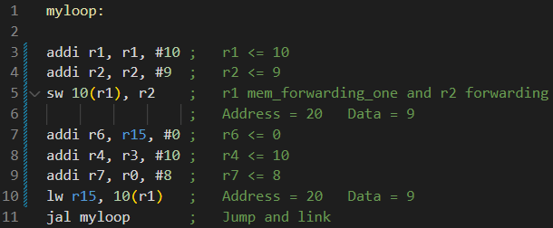
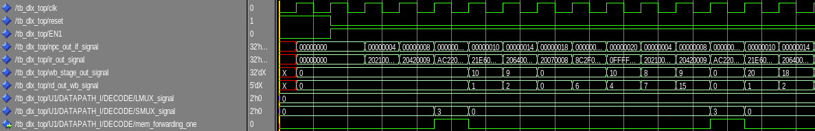
.asm file: load/store + jump instructions
When the store is decoded the mem_forwarding_one for r1 is enabled and the forwarding for r2 is activated.

Slide 18

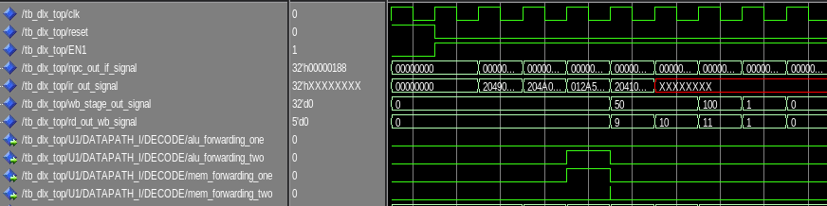
.asm file: forwarding hazards instructions
We expect signals alu_two_forwarding and mem_one_forwarding active in the third instruction.

Slide 19
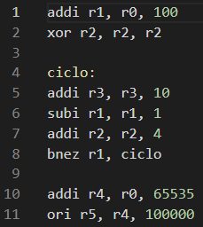
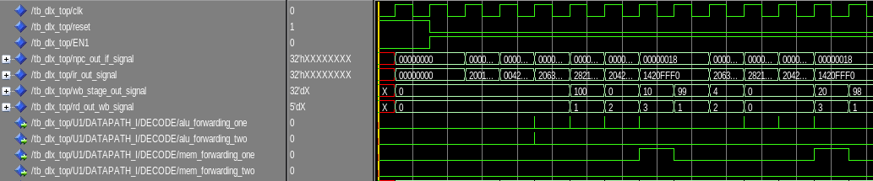
.asm file: branch instructions
The value of r1 is initialized in the first instruction, then it’s decreased by the sub instruction and the value of r1 is compared by the bnez instruction. When the bnez is in decode it requires the content of the register r1 to perform the comparison, so r1 is forwarded directly at the input of the alu in the EXE stage. We expect the signal mem_forwarding_one active in the decode of the bnez instruction.

